Slide 1
Single Row Functions
Lecture 02

Slide 2
Agenda
Character Functions
Numeric Functions
Datetime Functions
Conversion Functions
General Comparison Functions

Slide 3
SQL Functions
There are two types of functions:
Single-row
Multiple-row
A single-row function returns one result for each row. These functions operate on single rows only and return one result for every row acted on.
There are different types of Single-Row functions as follows:
Character
Number
Date
Conversion
General
A multiple-row function returns one result per set of rows. Functions can manipulate groups of rows to give one result per group of rows. These functions are also called group functions.

Slide 4
Single-Row Functions
Single-row functions return a single result for each row in the result set.
Single-row functions can be used in
SELECT
WHERE
HAVING
ORDER BY
Functions can be used to
Perform calculations on data
Modify individual data items
Manipulate output for groups of rows
Format dates and numbers for display
Convert column data types
SQL functions may take arguments and always return a value.

Slide 5
Single-Row functions
These functions manipulate data items.
Be a set to one or more arguments and return a single value for each row that is retrieved by the query.
An argument can be one of the following:
User supplied constant
Variable value
Column name
Expression
The actions of single row functions include:
Acts on each row that is returned by the query
Returns one result per row
May possibly return a different data type than the one that is referenced
The function expects one or more arguments

Slide 6
Character Functions

Slide 7
Character Functions
These functions accept character type arguments and return character or numeric values.
Character functions:
Case manipulation
LOWER
UPPER
INITCAP
Character manipulation
SUBSTR
CONCAT
LENGTH
INSTR
TRIM
REPLACE

Slide 8
Case Manipulation Functions
Function | Returning result
LOWER(‘DATABASE Systems’) | database systems
UPPER (‘database sYstems’) | DATABASE SYSTEMS
INTCAP(‘database Systems’) | Database Systems
LOWER()
returns the character argument with all lower case letters.
UPPER()
returns the character argument with all upper case letters.
INITCAP()
returns each world with the first letter capital and other letters lower case.
Words are delimited by white space or characters that are not alphanumeric.

Slide 9
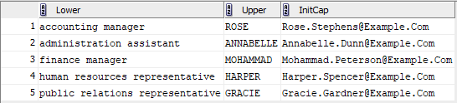
Case Manipulation Functions (SQL Example 1)
SELECT LOWER(job_title) AS "Lower",
UPPER(first_name) AS "upper",
INITCAP(email) AS "Initcap"
FROM ass_employees
WHERE manager_id = 2;

Slide 10
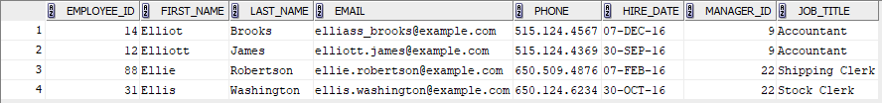
Case Manipulation Functions (SQL Example 2)
The following SQL query returns employees with “elli” word in their first name. To make sure you find all matching patterns, you can use LOWER() or UPPER() functions on the left side of the comparison expression and a matching pattern or word with all letters lower case of capital on the right hand side of the comparison expression.
select *
FROM employees
WHERE LOWER(first_name) LIKE 'elli%';

Slide 11
Character Manipulation Functions
Function | Returning result
CONCAT(‘Database’, ‘Systems’) | DatabaseSystems
SUBSTR (‘DatabaseSystems’,1,4) | Data
LENGTH(‘DatabaseSystems’) | 15
INSTR(‘DatabaseSystems’, ‘b’) | 5
LPAD(‘Tommy’, 10, ‘*’) | *****Tommy
RPAD(‘Tommy’, 10, ‘*’) | Tommy*****
REPLACE(‘Jack and Jue’, ‘J’, ‘Bl’) | Black and Blue
TRIM(‘D’ FROM ‘Database’) | atabase

Slide 12
Numeric Functions

Slide 13
Numeric Functions
Function | Returning result
ROUND(5.678, 2) | 5.68
TRUNC(5.678, 2) | 5.67
MOD(10, 3) | 1
ROUND(v, n)
It receives two arguments.
v: is a value of any numeric data type.
n: is an integer value.
returns the argument value v rounded to n places to the right of the decimal point.

Slide 14
ROUND()
ROUND(v, n)
It receives two arguments.
v: is a value of any numeric data type.
n: is an integer value.
returns the argument value v rounded to n places to the right of the decimal point.
The ROUND() function with out the second parameter n, the default value 0 will be considered for the second argument.
If you use 0 or no value for the second argument, n is rounded to zero decimal places.
ROUND(10.96) → 11

Slide 15
TRUNC()
TRUNC(v, n)
truncates a number n to v decimal places.
TRUNC(15.193, 2) → 15.19
TRUNC(15.193, 3) → 15
TRUNC(15.193, 1) →15.1
TRUNC(n)
truncate a number n to zero decimal places.
TRUNC(15.193) → 15

Slide 16
MOD()
MOD(v, n)
n: dividend
v: divider
The function MOD() returns the remainder of the division of n and v.
MOD(121,14) → 9
MOD(25, 7) → 4
The MOD() function is used to determine if a number is odd or even.

Slide 17
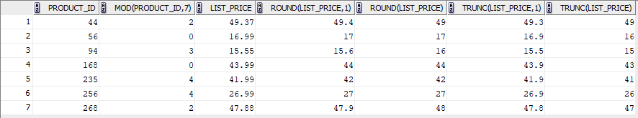
Numeric Function Example
SELECT product_id, MOD(product_id,7),
list_price, ROUND(list_price,1) , ROUND(list_price),
TRUNC(list_price,1), TRUNC(list_price)
FROM ass_products
WHERE list_price < 50
ORDER BY product_id;

Slide 18
Datetime Functions

Slide 19
Dates
The default display and input format for any date is DD-MON-RR. Valid Oracle dates are between January 1, 4712 B.C., and December 31, 9999 A.D.
In the example in the slide, the HIRE_DATE column output is displayed in the default format DD-MON-RR. However, dates are not stored in the database in this format. All the components of the date and time are stored. So, although a HIRE_DATE such as 17-JUN-87 is displayed as day, month, and year, there is also time and century information associated with the date. The complete data might be June 17, 1987, 5:10:43 p.m.
CENTURY YEAR MONTH DAY HOUR MINUTE SECOND
19 87 06 17 17 10 43
Note: century or year stored as 4 digits even if displayed as 2

Slide 20

SYSDATE
SYSDATE returns current
Date
Time
SELECT SYSDATE
FROM dual;

Slide 21

Arithmetic Operations on Dates
Since Oracle database stores dates as numbers, arithmetic operations such as addition or subtraction can be performed on date values. You can add or subtract both numbers and dates to or from date values.
Date + Number
Date – Number
Date – Date
Example:
The next billing due date is calculated which 30 days from today.
SELECT sysdate, sysdate + 30
FROM dual;

Slide 22
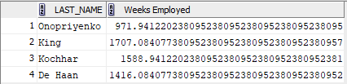
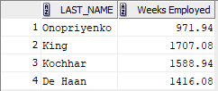
Dates and Arithmetic Operators
Example: Find how many weeks an employee has worked at the company?
To improve the result format, we use function TRUNC()
SELECT last_name, (sysdate - hire_date)/7 "Weeks Employed" -- returns days convert to weeks
FROM employees
WHERE department_id = 90;
SELECT last_name, TRUNC((sysdate - hire_date)/7,2) "Weeks Employed"
FROM employees
WHERE department_id = 90;

